Slide 1

Air bnb Analysis

Slide 2
Objective :
The task is to generate an ML based solution that can be used to suggest appropriate listing prices to the property owner when they try to list a property out for rent.
To analyze the attributes and find the relation of those attributes with the target variable i.e. price of the property

Slide 3
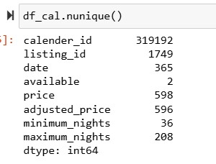
Data Understanding and feature creation (Task 1):
Look at the table calendar how many rows and unique listing ids are present? Are there any implications when it comes to having more rows and less unique ids?
Having more rows means there are more individual entries in the dataset, which could potentially provide more detailed information about bookings over time.
Having fewer unique listing IDs relative to the number of rows could imply either multiple bookings for the same listing or listings being available for different periods, which could effect certain analyses, such as occupancy rate or pricing strategies.
Number of rows in calendar table : 319192
Number of unique listing id’s in calendar table = 1749

Slide 4
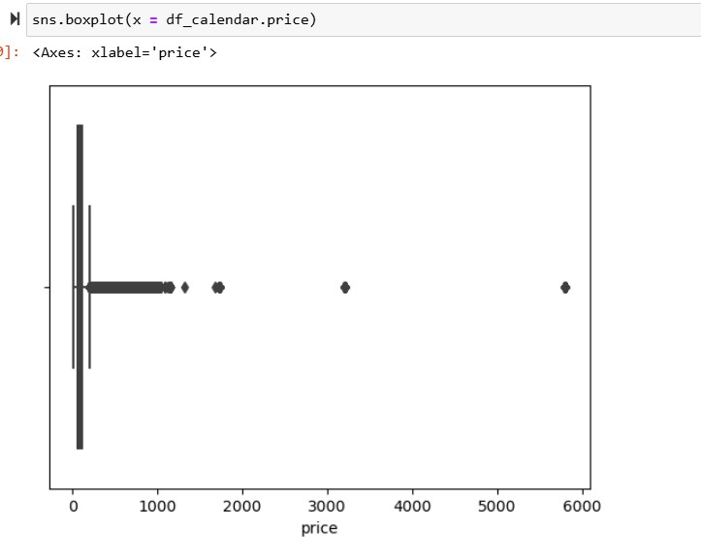
Data Understanding and feature creation (Task 1):
Look at the price column in Calendar table. What transformations you will need to perform so that you can create a column that can be used as a target/response variable?
To prepare the price column in the Calendar table to be used as a target/response variable, we need to perform several transformations:
Data Type Conversion: Ensure that the price column is in numeric format (e.g., float or integer) rather than a string/object type.
Handling Missing Values: Check for missing values in the price column and decide on a strategy to handle them, such as imputation with the mean, median, or a specific value, or removing rows with missing prices if appropriate.
Outlier Detection and Removal: Identify and handle outliers in the price column using boxplot. Extreme prices may distort the model's predictions, so it's essential to address them appropriately, either by removing them or transforming them.

Slide 5
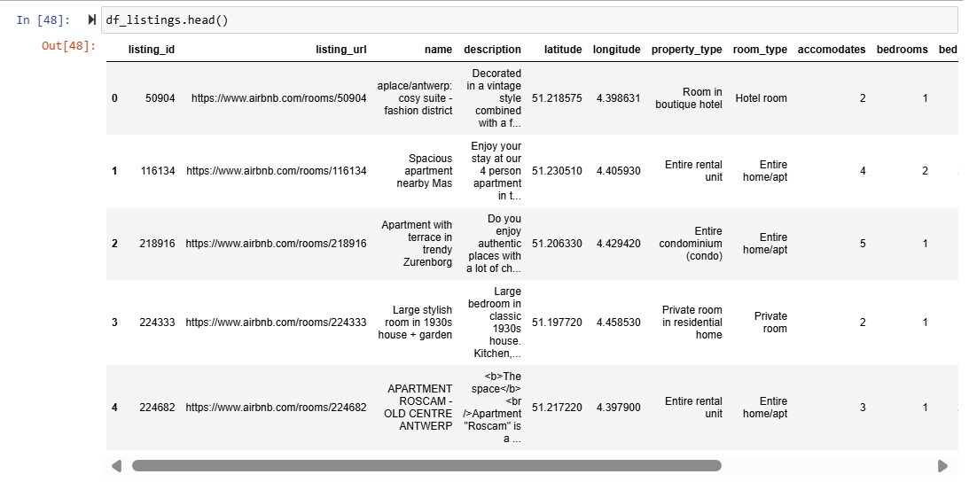
Data Understanding and feature creation (Task 1):
Look at the tables Listings, Hosts and Reviews to come up with a list of potential transformations needed in order to have predictors that can be used to predict the listing price.

Slide 6
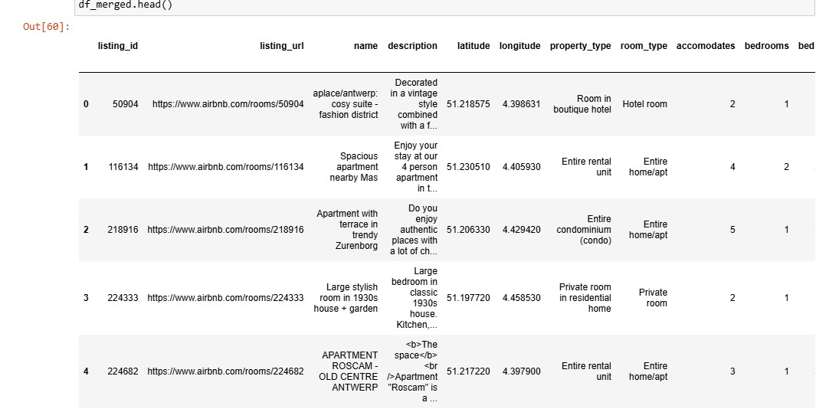
Data Understanding and feature creation (Task 1):
Create an aggregate view of data spread across different tables, containing the target as well as predictor variables.

Slide 7
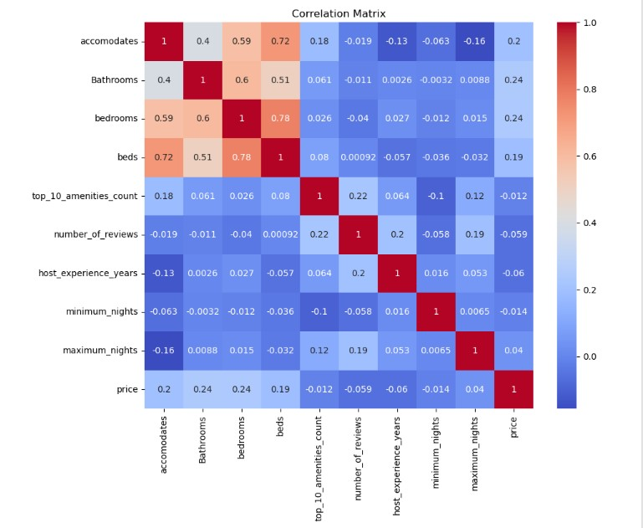
Variable profiling and checking relationship between variables (Task 2) :
Assess the relationship between target and predictor variables. You can compute correlations, plot bivariate relationships
Price corelations :
Bathrooms number : the number of bathrooms has a moderate positive correlation with price(0.24).
Bed rooms: The number of bedrooms shows a positive corelation with price (0.25).
Accommodates : the number of people the listing can accommodate has a lower positive corelation with price(0.20).
Inter – Feature correlations:
Accommodates and beds : There is a strong positive corelation between the number of people accommodated and the number of beds (0.72)
Bedrooms and beds : bedrooms and beds also have a strong positive correlation(0.81)
Accommodates and Bedrooms: These two features show a strong positive correlation(0.58).
Weak or Negative correlations :
Host Age : Host Age Generally shows weak correlations with other features.
Min and Max nights : these show weak correlations with most features, including price
Top 10 Amenities count: This has weak correlations with cost features, indicating that the number of Amenities does not strongly relate to the other numerical variables in the dataset

Slide 8
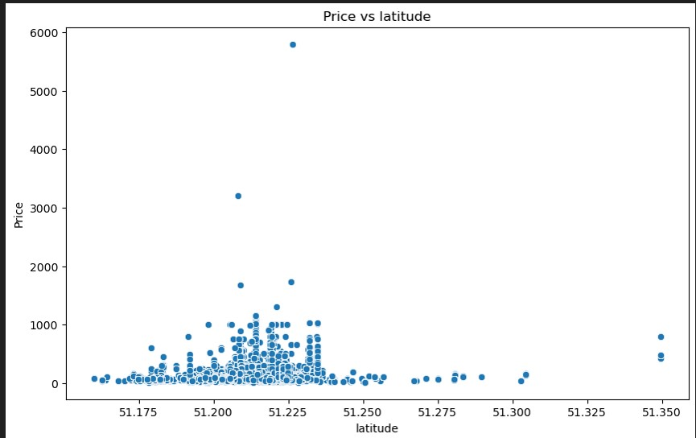
Variable profiling and checking relationship between variables (Task 2) :
Plot bivariate relationships using scatterplot
Analysis by latitude :
Most of the properties are located between 51.207870 and 51.220905
Prices of the properties are high between the latitude 51.200 and 51.250

Slide 9
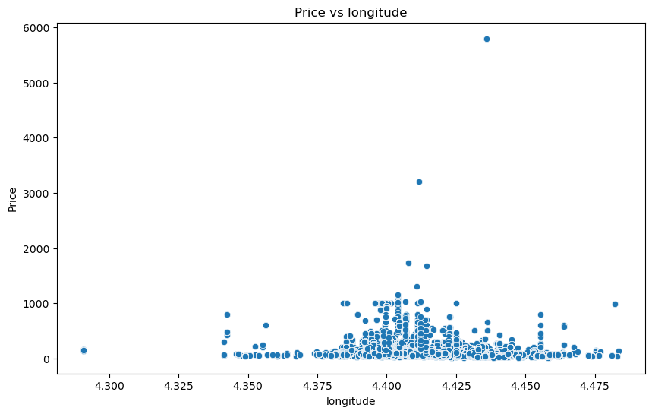
Variable profiling and checking relationship between variables (Task 2) :
Analysis by longitude :
Most of the properties are located between 4.400140 and 4.424660
Prices of the properties are relatively high between the longitudes

Slide 10
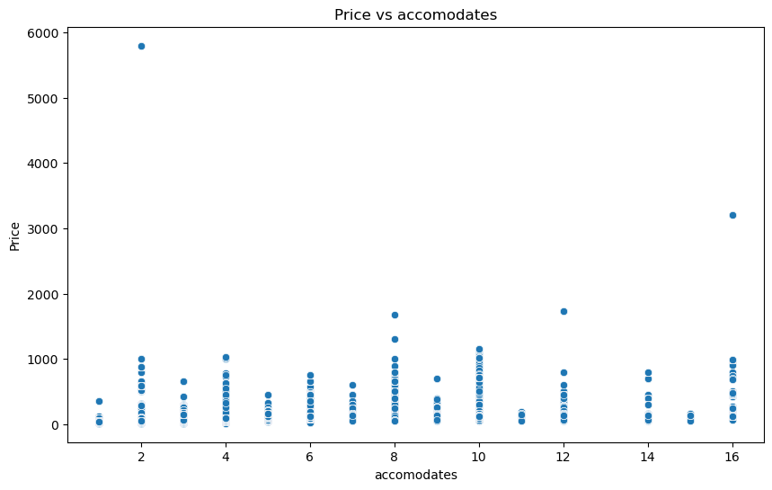
Variable profiling and checking relationship between variables (Task 2) :
Analysis by Accommodates :
The accommodates varies from 1 to 16 depending on the property type.
The prices of the even number of accommodations are relatively higher

Slide 11
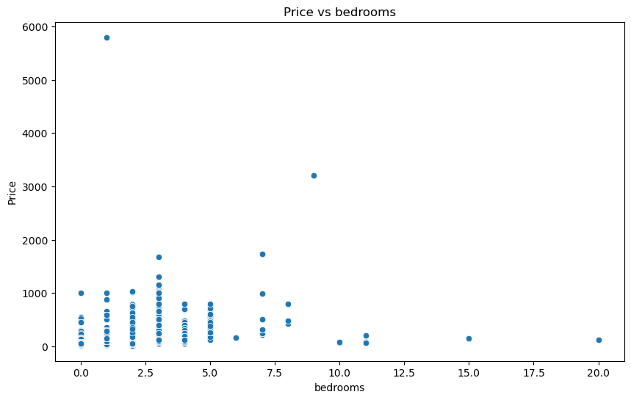
Variable profiling and checking relationship between variables (Task 2) :
Analysis by Bedrooms :
Most of the properties offer 1 to 5 bedrooms according to the room type.
The highest price was for a single bed room.

Slide 12
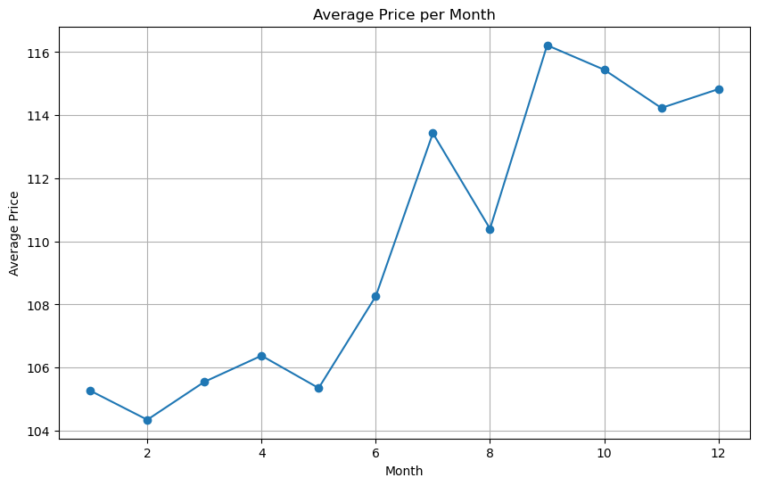
Variable profiling and checking relationship between variables (Task 2) :
Analysis using line chart on the basis of Change in Average price of Property Monthly
Analysis by Booking month :
The Average price increases in the winters

Slide 13
Variable profiling and checking relationship between variables (Task 2) :
Based on the above analysis summarize your findings and list down the transformations you will do on different predictors, remove the variables from further analysis.
Analysis by Bathrooms:
Most of the properties offer 1 to 5 bathrooms.
The price increases when the bathroom count reaches 3 and then decreases.
Analysis by Amenities:
The price increases when the property offers more basic amenities that are provided by all the properties.
Analysis by Minimum Nights:
Most of the properties offer a minimum of 5 nights stay.
Analysis by Maximum Nights:
Most of the properties offer a maximum of 813 nights stay.
Analysis by Distance to Airport:
Most properties are located within 4.55 km distance from the airport.
The price is high when the distance is between 3 to 6 km.
Analysis by Distance to Railway:
Most properties are located within 1.73 km distance from the railway station.
The price is high when the distance is between 0 to 2 km.

Slide 14
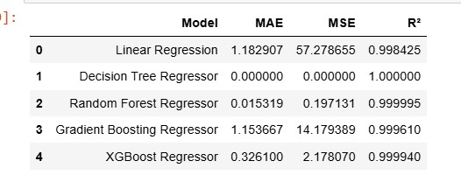
Modelling and insights (Task 2):
Explain your approach on creating train/test/validation splits
Training & Testing: Assuming merged_df is our final preprocessed data frame and ‘price’ is the target variable.
X – predictor/input and Y – Target Variable(price)
Split the Data into 2 parts, validation set = Training set & Test set by 70/30 ratio(%)
By default random state =0
Random state = Int value
Create a comparison matrix to compare different regression models you've run
We'll create a function to evaluate different regression models and compare their performance using metrics such as Mean Absolute Error (MAE), Mean Squared Error (MSE), and R-squared (R²).

Slide 15
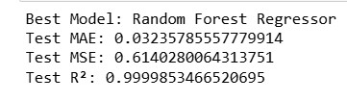
Modelling and insights (Task 2):
Explanation of the Finalized Model
Model Finalized: Random Forest Regressor
Reason for Finalization: The Random Forest Regressor had the lowest MAE and MSE, and the highest R² score among all models tested, indicating superior performance in predicting the target variable.
Top 5 Most Important Predictors:
property_type_Private room in townhouse: High importance value, indicates it significantly influences the target variable. property_type_Entire villa: High importance value, second most influential predictor. accomodates: Moderate importance value, third most influential. distance_to_railway_station: Lower importance value, fourth most influential. latitude: Lowest importance value among the top 5, but still significant.
Direction of Impact: Generally, in tree-based models like Random Forest, higher importance means the feature is more frequently used in the splits and thus has a more significant impact on the predictions. However, the direction (positive or negative) would need further analysis using partial dependence plots or similar techniques.
This approach gives a comprehensive understanding of model performance and the significance of each predictor.

Slide 16
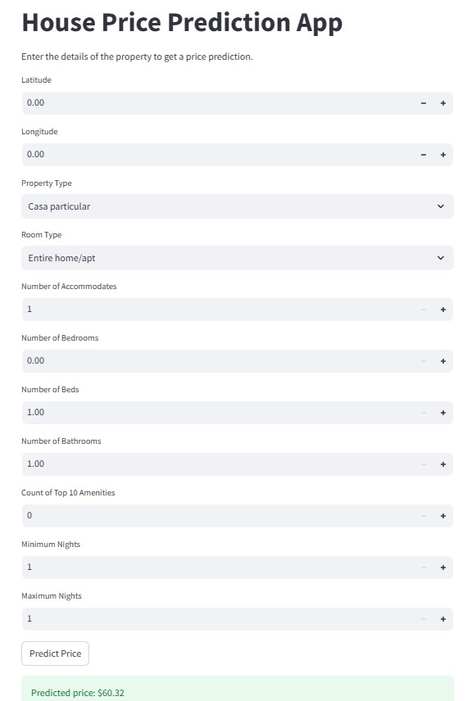
Deployment of final model:

Slide 17
Thank you

